Slide 1
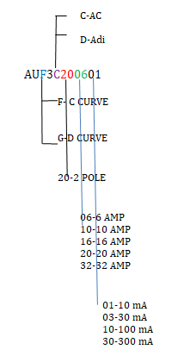
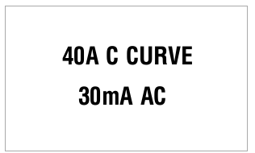
^XA
^CF0,30
^FO70,50^FD40A C CURVE^FS
^FO90,100^FD30mA AC^FS
^XZ
40
c
AC
30
Rating sticker

Slide 2
^XA
^CF0,30
^FO50,50^FD%S1A %S2 CURVE^FS
^FO70,100^FD%S3mA %S4^FS
^XZ
40
%S1
C
%S2
30
%S3
AC
%S4
%S1 = F/G CURVE
%S2 = C/D --AC Adi
%S3 = A
%s4 = mA

